Slide 1
Mapping Heracles Implementation
Matthew Kalan
Rob Fitzgerald
Nathan Justice

Slide 2
RDMA Research

Slide 3
RDMA Send and Receive
Review
Motivation
RDMA send and RDMA Receive
Trace files and trace program
Findings

Slide 4
Review
We have covered InfiniBand as an emerging technology that is gaining rapid acceptance in the HPG domain. The architecture is an industry standard interconnection technology which aims to provide low latency and high bandwidth communication.
Our focus is on InfiniBand Implementation of the connectX3 adapter and switchX2 from Mellanox Tech which is on Heracles.We have find out the adapter’s architecture, design and processing capabilities in our research presentation.
From our research paper, Connect X adapter architecture was used. It enhances the scalability and performance of InfiniBand on multicore clusters. It is also a network interface adapter.

Slide 5
Motivation
The main goal of this section of the program is to pass message(s) from one node to another using RDMA and to record the manner in which the message is passed, based on the RDMA send and RDMA receive

Slide 6
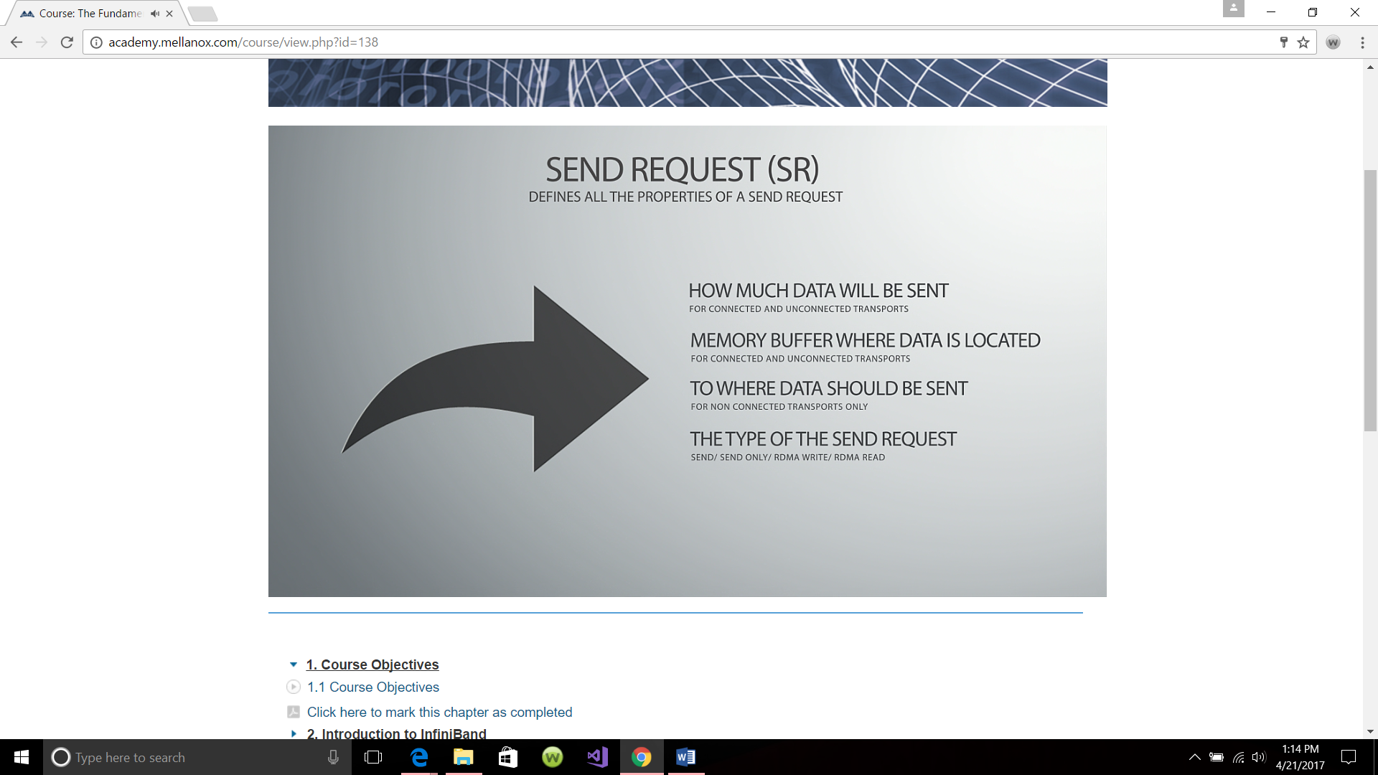
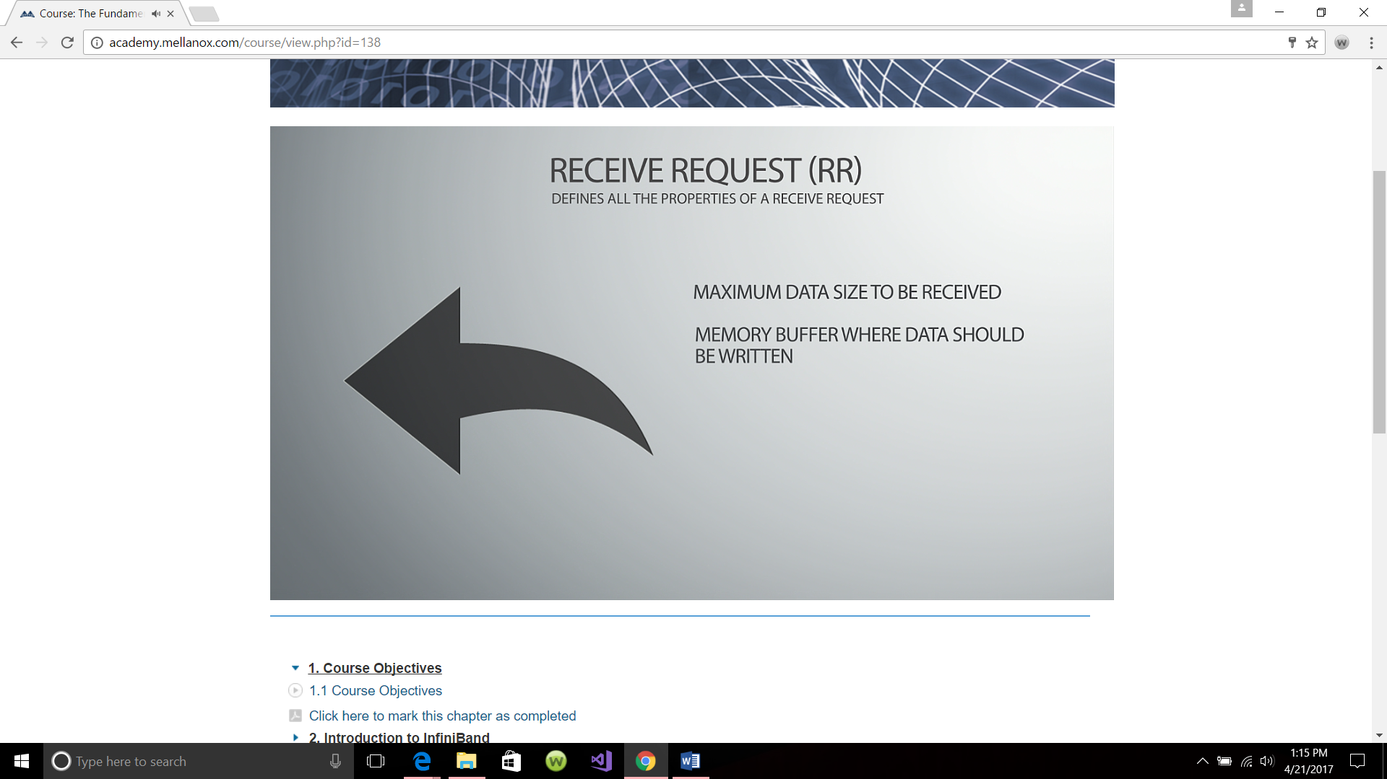
Criteria for RDMA send and receive

Slide 7
RDMA send and RDMA receive
RDMA send Functions used to implement send data in the project includes
Ibv_get_device_list: Use to get the device list in the fabric
Ibv_alloc_pd(): Used to allocate the protection domain in the send side, so no other domain has access to the message except those nodes in the domain
Ibv_reg_mr(): Used to allocate memory
Ibv_create_cq(): Use to create the completion queue on the send side
Ibv_create_qp(): Use to create the queue pair
Ibv_post_send() : Used to pass the message from the send side
Ibv_poll_cq(): Gathers all the event between the send and receive and send it to the report field of the status entry

Slide 8
RDMA receive
Functions used to implement the receive data includes
Ibv_alloc_pd(): Used to allocate the protection domain in the receive side, so no other domain can respond to the send request.
Ibv_reg_mr():Used to allocate a memory location in the receive side
Ibv_create_cq():Used to create a completion queue in the receive side
Ibv_create_qp(): Used to create a queue pair that communicates with the queue pair of the send side
Recv_cq: Used to receive the completion queue of the send side
List.addr: This matches the address requirements of the send side
Ibv_post_recv(): Used to send information to the send request that the message sent to it has been received
Notes:
These functions are the bedrock of RDMA send and RDMA receive. They have been created by Mellanox as benchmarks, all we need to do is implement them in our codes.

Slide 9
Trace Program
So, using a simple program code, a message was passed in the Mellanox platform, and we decided to use MLNX_Tracer as one of the trace benchmarks. However, Mellanox already converted MLNX_Tracer into an application used to implement RDMA send and RDMA receive. This application needs to be installed in for it to be used. The tracer, monitors every message that is sent or received in the RDMA region. It also stores a system time for each message. The time it takes for the message to be created in the work queue, the time it take for the message to be sent and the time it take for the message to be received.
Another tracer used is sniffer.pcap this tracer does the same function as the MLNX_Tracer but it is embedded in the code and not as an application like MLNX_Tracer.

Slide 10
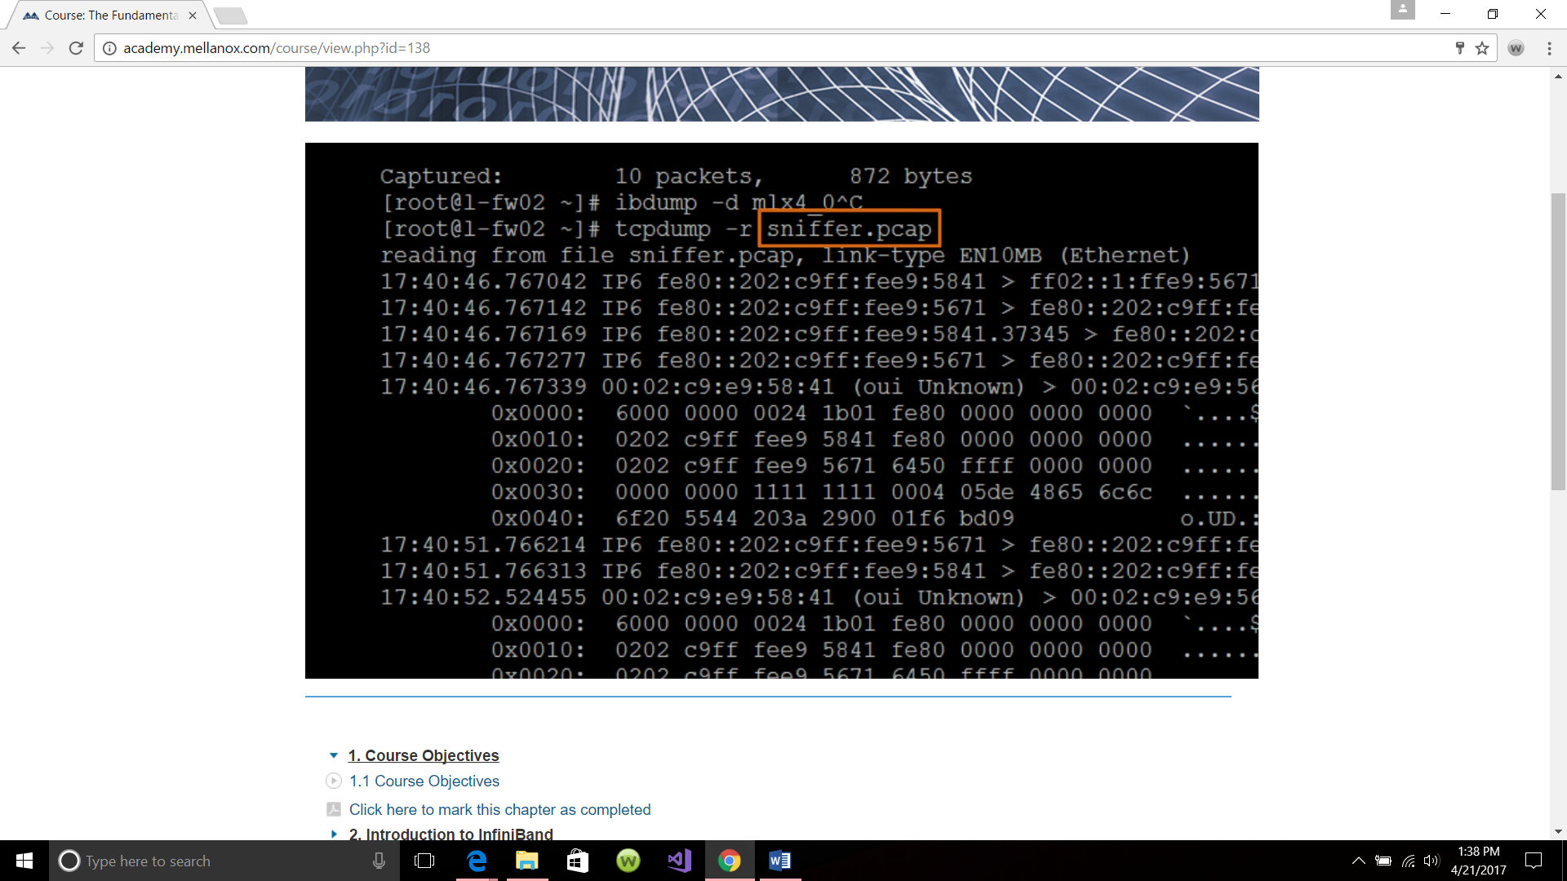
Tracer file

Slide 11
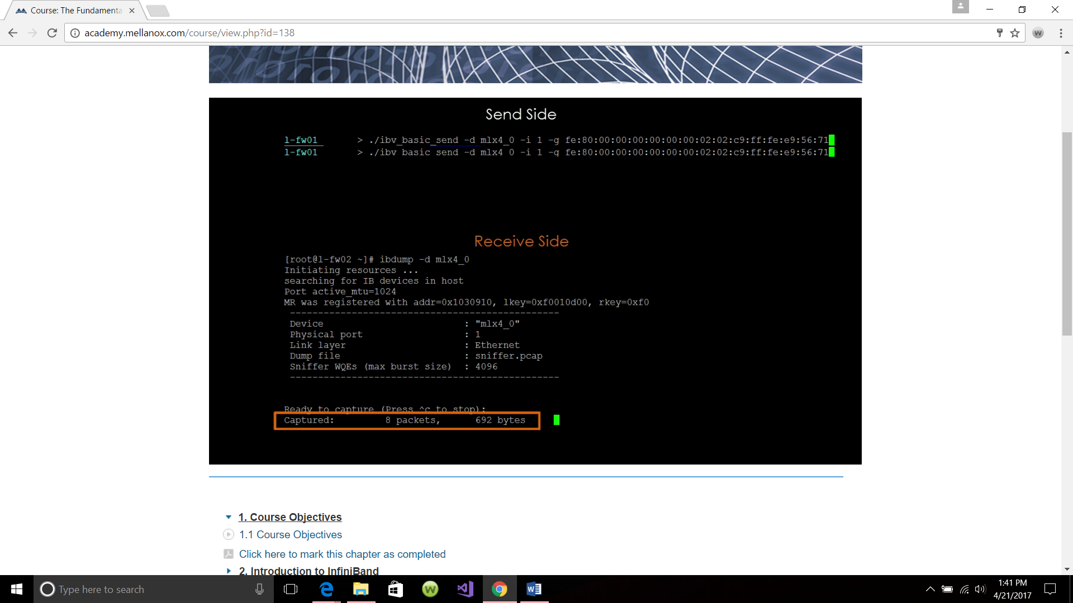
Output of RDMA Send and Receive

Slide 12
Findings
An interesting finding was made.
When a message is passed from one node to another, if the specifications of the sending message node is not met by the next node close in path to it identified by the switch, it will keep throwing out request, called “scatter gather.”
When eventually a node with the specification is met, it uses shortest path algorithm to send information to that node that meets the specification. So, for example, node 2 sends a work request and node 10 is the only node that has that specification, if node 10 is busy at the moment, a time slice will be given to node two by the switch, and it then looks for another node to pass the message to, say node 5 for example, pending when node 10 will finish its operation. Node 2 may pass it to node 5, whose job is just to hold for a while and then send to node 10. When node 10 finishes its job, the process ID is sent to it and memory is pinned. And node 5 passes the information to node 10.

Slide 13
Another interesting finding was interrupt.
As a message was sent, on the platform, for some reason, an error code was displayed, which means there was an interrupt somewhere. I went ahead to send another message and a third message using that same node. And all the preceding messages kept returning error as there work completion queue. So, I sent an email to the Mellanox team stating my finding. The response was, “All transactions posted in the same QP after the falling transaction will be completed with an error syndrome.” In order words, if a message is sent, and there is an error message occurs, due to interrupt, every other message in the receiving node will all show up in the completion queue as “error receiving message.” This will continue to happen until the reason for the interrupt is investigated or memory freed.

Slide 14
MPI follows
One reason why we got an error or interrupt is due to inadequate memory allocation for the transfer of memory.
With the tracers and functions used in the research code, I realized that the pattern of communication using RDMA depends on:
1. The size of the memory
2. The availability of hardware at the time the message will be sent
3. The size of the message
My colleagues will present MPI patterns and other interesting implementation activities.

Slide 15
Implementation

Slide 16
Implementation
Modules
Dependencies
Results
Challenges

Slide 17
Modules
A baseline MPI test to come up with average node-to-node communication time for all node combinations
Parameterized test scripts
Data analysis of the MPI communication
RDMA trace of our application
Additional tests to show impact of increased process workloads and communication payloads
Simple compile and run instructions

Slide 18
Dependencies
C++ (Test Application Code)
Open MPI (Message Passing Library)
Slurm (Distributed MPI Job Manager)
Python (Log Parsing and Statistics)
Scala (Script Generation)
Numbers (Plotting)

Slide 19
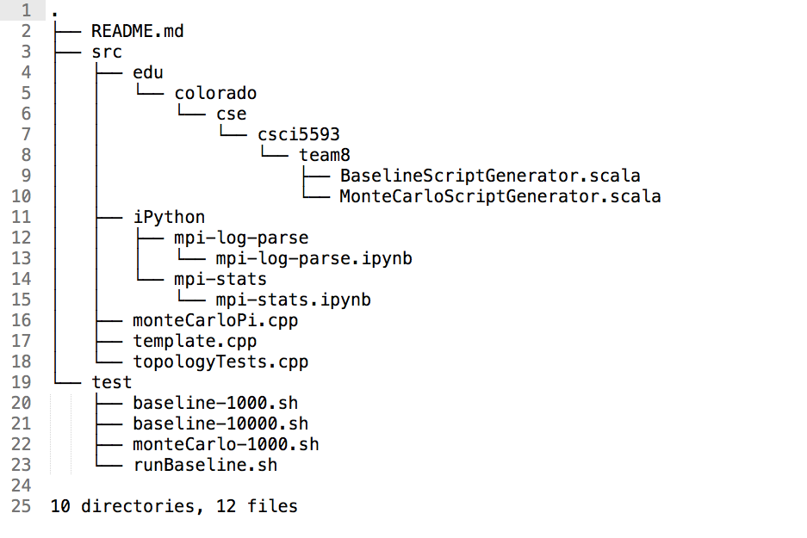
Dependencies : Current Implementation

Slide 20
Results : Baseline
Running exactly two nodes transacting 1000 messages, for each pair, for each direction (sender->receiver): 240 combinations
Resulting log: 83.4MB for this baseline test

Slide 21
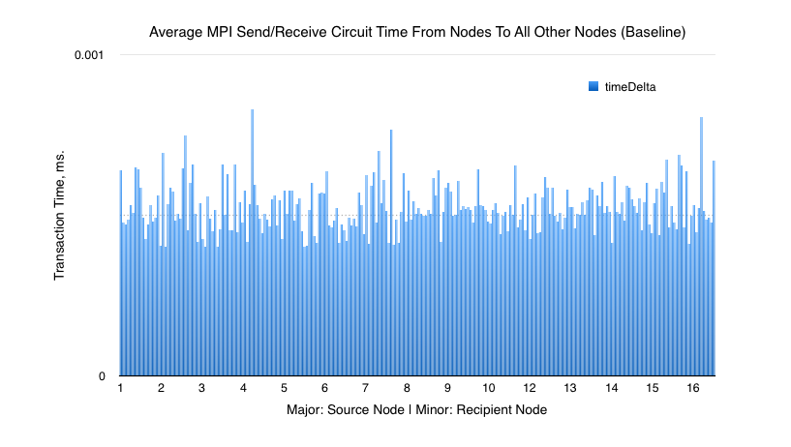
Results : Baseline Heracles MPI Performance - 1000 Msg Test

Slide 22
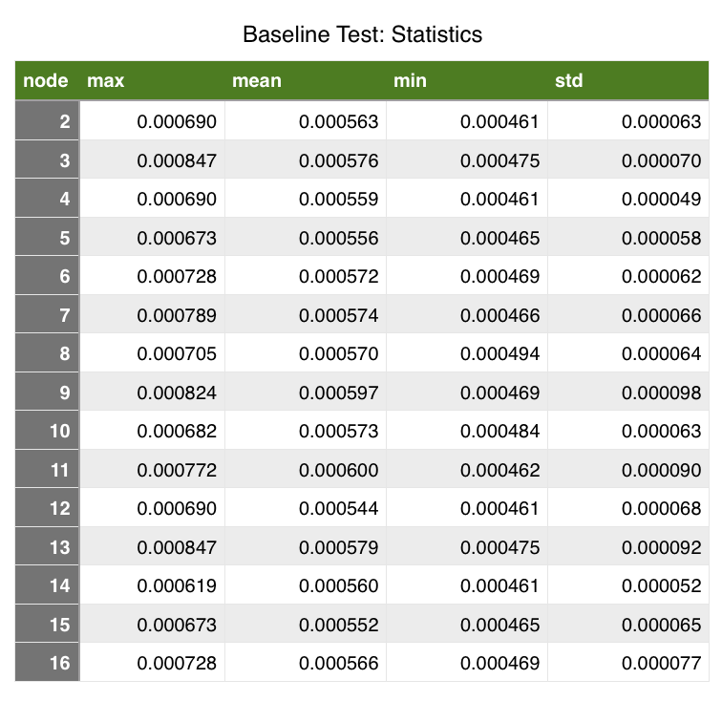
Results : Baseline Heracles MPI Performance - Stats

Slide 23
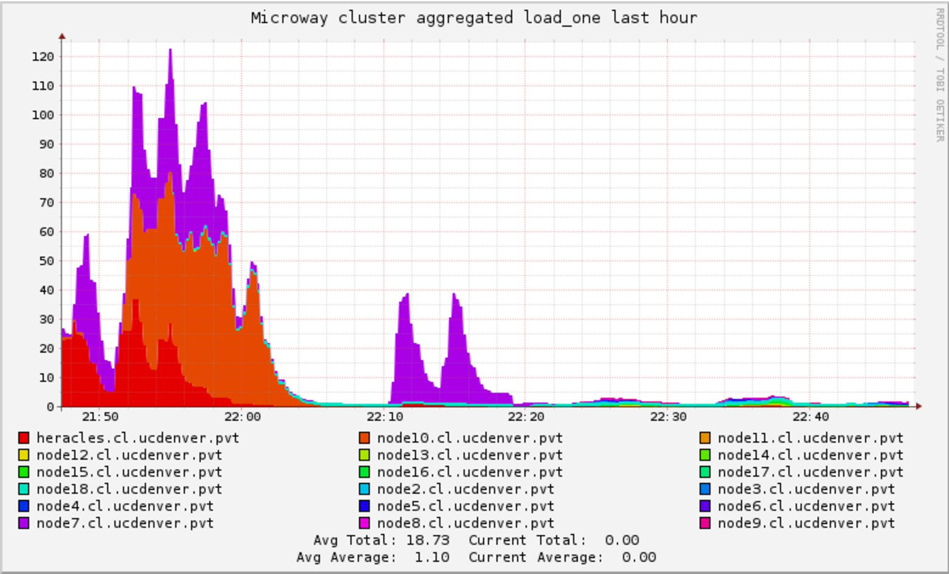
Results : Cluster CPU Usage Monitor

Slide 24
Challenges
Warm-up phase
Deciding what is “correct” for logging time
Unfamiliarity with Slurm commands and job management
Logging to standard output from multiple processes

Slide 25
Topology Tests

Slide 26
Hypothesis
We anticipate Heracles’ network to reflect the topology of a complete connected graph.
This will be represented Heracles’ clusters performing optimally in all topology formations.

Slide 27
Ring Topology
if (proc != 0) {
MPI_Recv(&token, 1, MPI_INT, proc - 1, 0, MPI_COMM_WORLD, MPI_STATUS_IGNORE);
}
// Send all messages
MPI_Send(&token, 1, MPI_INT, (proc + 1) % numProcs, 0, MPI_COMM_WORLD);
// Now process 0 can receive from the last process.
if (proc == 0) {
MPI_Recv(&token, 1, MPI_INT, numProcs - 1, 0, MPI_COMM_WORLD, MPI_STATUS_IGNORE);
}

Slide 28
Star Topology
if (proc != center) {
MPI_Recv(&token, 1, MPI_INT, center, 0, MPI_COMM_WORLD, MPI_STATUS_IGNORE); //Send a response
MPI_Send(&token, 1, MPI_INT, center % numProcs, 0, MPI_COMM_WORLD);
} else {
// Set the token's value if you are center
for(int j = 0; j < numProcs; ++j){
if(j != proc){
MPI_Send(&token, 1, MPI_INT, j % numProcs, 0, MPI_COMM_WORLD); //Receive responses
MPI_Recv(&token, 1, MPI_INT, j, 0, MPI_COMM_WORLD, MPI_STATUS_IGNORE);
}
}
}

Slide 29
Complete Topology
//receive all messages before your turn to send
if (proc != 0) {
for(int j = 0; j < proc; ++j){
MPI_Recv(&token, 1, MPI_INT, j, 0, MPI_COMM_WORLD, MPI_STATUS_IGNORE);
}
}
//Send all of your messages
for(int j = 0; j < numProcs; ++j){
if(j != proc){
MPI_Send(&token, 1, MPI_INT, j % numProcs, 0, MPI_COMM_WORLD);
}
}
//receive all messages after your turn to send
for(int j = proc + 1; j < numProcs; ++j){
MPI_Recv(&token, 1, MPI_INT, j, 0, MPI_COMM_WORLD, MPI_STATUS_IGNORE);
}

Slide 30
Traffic Tests

Slide 31
Factors that affect message time
Total number of messages
Total number of process endpoints
Division of processes among nodes
Total number of nodes

Slide 32
Factors that affect message time (cont)
Message Size
Memory Limits
Blocked processes

Slide 33
Foreseeable hurdles
Data management
A variety of parameters
Uncontrollable traffic
Process allocation

Slide 34
questions?
Team 8 • Nathan Justice • Rob Fitzgerald • Matthew Kalan • Mapping Heracles Implementation

